Slide 1
Worktime Focus &
Communication on Remote Teams

Slide 2
Agenda
THE POWER OF COMMUNICATION (10-15 minutes)
GETTING IN A GROOVE (10-15 minutes)
DISCUSSION: WHAT CAN YOU DO? (5 minutes)
WRAP UP

Slide 3

The Power of Communication

Slide 4
Starting Activity:
Preferred Ways of Communicating
Take 3-5 minutes to complete this anonymous working preferences survey. We will review the results together as group.
Click this link to complete the survey

Slide 5
How to Communicate
Which communication channel makes the most sense to…
 | IM | Phone | Video call | Email | Teams
Provide a quick update
Announce a new policy
Discuss a sensitive topic
Share a joke or meme
Demonstrate a task
Share a document
X
X
X
X
X
X
X

Slide 6

Remote Meeting –
Recommendations
Clear agenda and purpose
Established meeting roles
Various methods for group problem solving and decision making
Summary of action items and next steps (who and when)
Evaluate and continuously improve meetings

Slide 7
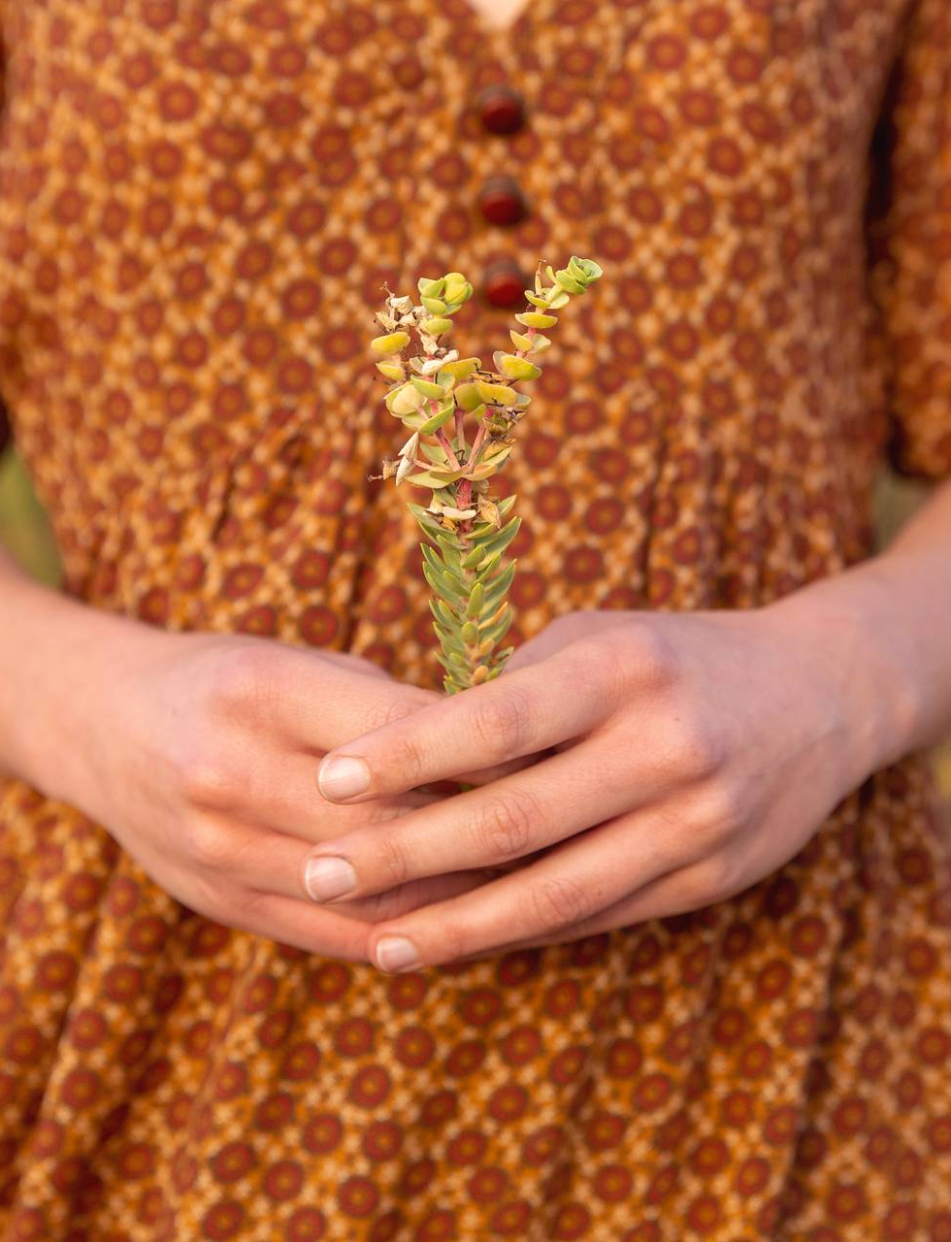
Getting into a Groove
Workplace Focus

Slide 8
First, some statistics…
According to a study at the University of California, the average adult working in an office stays on task for only 3 minutes at a time.
Another study at the University of Oregon found that is you are focused on a task and get interrupted - on average it will take you 23 minutes to get back to the same state of focus again.
Most US office workers NEVER get an hour of uninterrupted work in a typical day.
  The average CEO for a Fortune 500 company gets just 28 uninterrupted minutes a day.

Slide 9

More on Focus
Multitasking is a myth – human beings are very single minded
  Really, you’re just juggling, or switch tasking
  “Switch-cost effect” – your brain has to reconfigure and remember what you were doing before getting distracted. This takes time and energy.
  Errors are more likely when you backtrack to figure out where you left off with a task. Leads to more superficial thinking and creativity drain.
Flow states – e.g., athletic and creative endeavors
  Choose one goal
  Make sure the goal is meaningful to you
  Perform at the edge of your abilities
  *Flow states are fragile and easily disrupted.*
Benefits of mind wandering

Slide 10
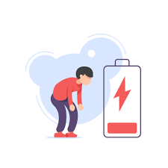



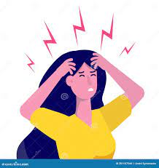

Digital Fatigue
General fatigue
Visual fatigue
Social fatigue
Motivational fatigue
Emotional fatigue
Blurred vision, irritated eyes
Want to be alone, avoid social interactions
Tired or mentally drained
Feel like doing nothing
Emotionally drained, moody

Slide 11
Discussion: What can you do?
Take a “virtual commute” to work
Avoid multitasking and start “monotasking”
Embrace mind-wandering – make your own tea ritual or fika ☺
Prioritize sleep – it’s essential for sustained focus
Intentionally take wellbeing breaks – not to catch up on chores or other work!
Set (and protect) boundaries where possible – blocking time, setting away messages, etc.

Slide 12
Thank you!

